Slide 1
Check in-2
Ahad Nardekar

Slide 2
work so far
Built and maintained a structured literature master sheet with full screening and detailed-review columns
Produced a model-family decision sheet comparing six families (lexicon, classical ML, fine-tuned encoders, generative LLMs, RAG, hybrid) on task fit, data needs, strengths, and weaknesses, anchored on one running report example.
Mapped the four reporting regimes (GRI, SASB, TCFD, ISSB/IFRS S2) against Scope 1, 2, and 3 requirements to separate mandatory from self-selected disclosure. [partly Raquel]
Built a working understanding of evaluation metrics (precision, recall, F1, accuracy) with a worked greenwashing-detector example, ready for when a classifier is validated.

Slide 3
Conclusions from the work so far
The decoupling result needs both halves, and the talk half is far more built than the walk half, so emissions and green capex extraction are now the bottleneck.
The hard part of the field is specificity, not classification: category tasks hit near-perfect F1 with simple baselines, while specificity sits at 0.17 agreement (P2), so the project's real risk is in the scoring step.
Classification, extraction, scoring, similarity, and sequence labelling are genuinely different jobs and each deserves its own model choice.
For a two-month replication package, a simple transparent stack (lexicon plus classical ML plus light LLM extraction) is cheap, reproducible

Slide 4
Conclusions from the work so far
LLM zero-shot extraction (the P10 route) is the most flexible option when labels are scarce, at the cost of reproducibility and hallucination risk that has to be validated.
Cosine similarity to TCFD categories captures which category a segment is in, not how committed it is, so it cannot be the TalkScore engine alone. Need to add confidence score as well.
RAGs can be used for extracting relevant texts from the long pdfs
No verified greenwashing dataset exists anywhere in the field (P2), so validation leans on proxy tasks and third-party signals and the project cannot claim confirmed greenwashing detection.

Slide 5
Limitations and dead ends
TalkScore's exact output is still undefined (single score, per-theme vector, specificity rating, or compliance-gap flag against the ISSB floor), and model choice can't be finalised until it is.
No verified ground truth exists, so there is no clean label to train or test on, so use the manual gap procedure as silver-standard labels on a small sample and state plainly it is a proxy.
The emissions and financial side is barely built and no firm-level dataset is defined, so lock a small fixed sample of HK/SG firms first and hand-build their emissions and capex series.
Cross-year panels are messy because firms only moved to ISSB recently and may restate baselines, so start single-year and treat time as a later extension, from Raquel’s work.
ClimateBERT may misfit ISSB content because it is TCFD-trained, so test it on a few ISSB reports before committing and keep an LLM route as backup, from Raquel’s work.

Slide 6
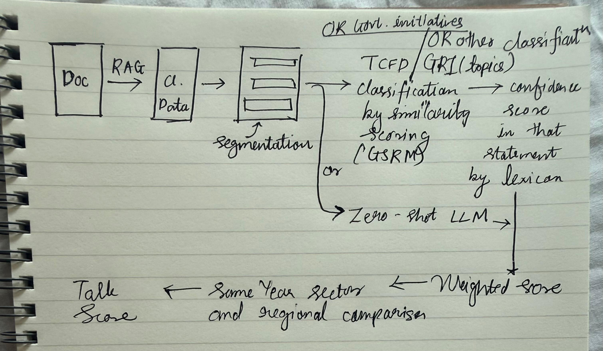
Proposed Model

Slide 7
Some Questions
What exactly should TalkScore output: one commitment score per firm, a score per ISSB theme, a specificity rating per pledge, or a flag for falling below the ISSB floor?
For the action side, is realised emissions trajectory enough, or do you want green capex and operational commitment included given how hard green capex is to extract?
With no verified Is single-year ISSB analysis acceptable as the main result, with cross-year as an extension, given firms only adopted ISSB recently?
Should peer comparison (firm versus sector norm) be part of the output, given P10's similarity machinery makes it cheap?
For green capex that cannot be isolated, is marking firms unknown and excluding them acceptable, or do you want a narrative proxy?

